Slide 1
B17 Meter System Dashboard Designation
Dekie Cheng
June 2023

Slide 2
Dashboard Structure
设目标用电数和百分比 （ By day, week ），超目标数，Auto发邮件通知后台脚本 。
Dashboard by Day, Week and Month
Dashboard 默认展示 by day 页面
报表：
This Photo by Unknown Author is licensed under CC BY-SA

Slide 3
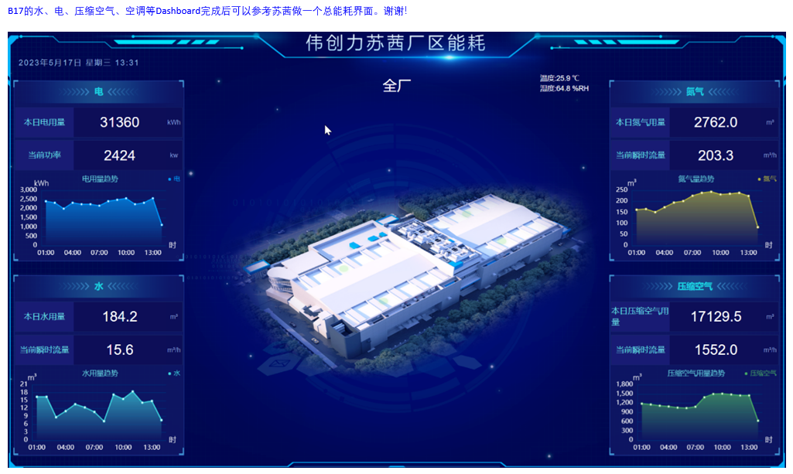
Dashboard Structure
空调流量计
累积热量 (Gj)
出水温度
By hour
By hour
By hour
By hour

Slide 4

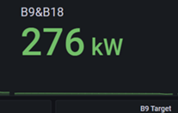
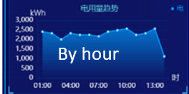
Dashboard Structure
This Photo by Unknown Author is licensed under CC BY-SA

Slide 5
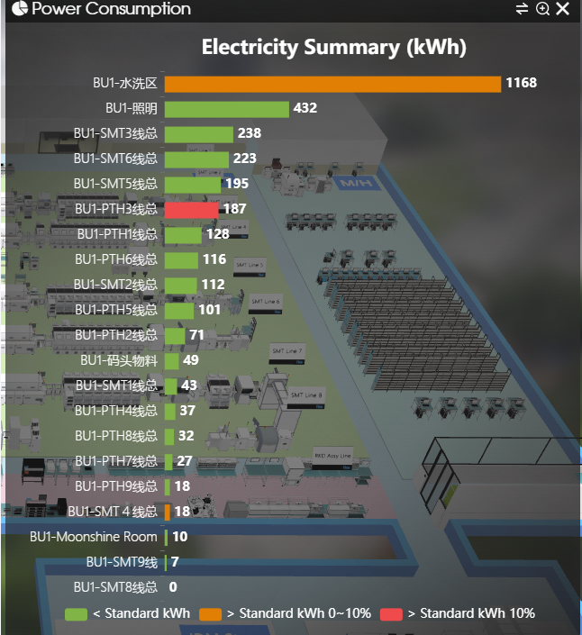
Dashboard Structure
This Photo by Unknown Author is licensed under CC BY-SA

Slide 6
Dashboard Structure
This Photo by Unknown Author is licensed under CC BY-SA

Slide 7

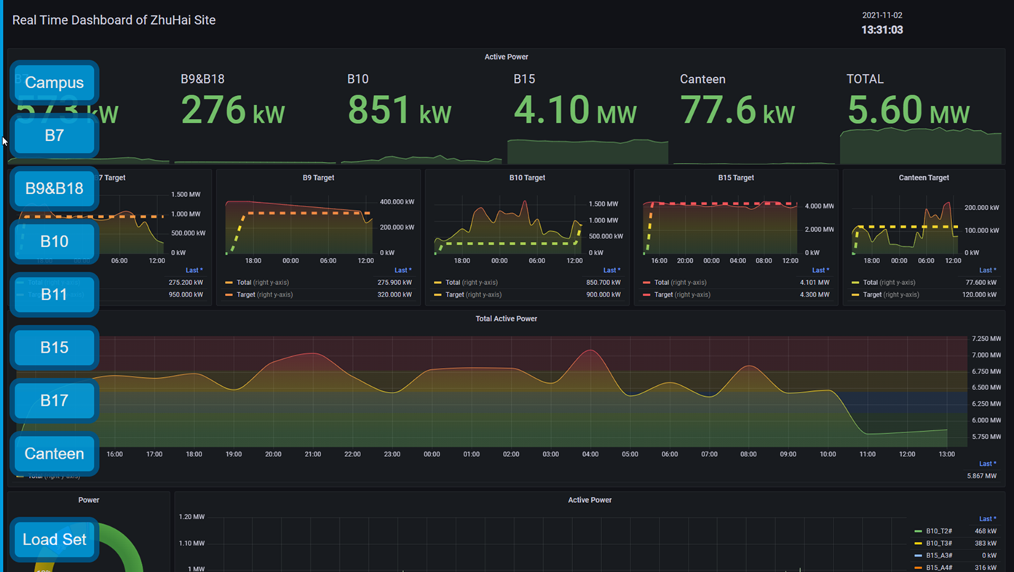

Dashboard Structure
Sample by day/week/month
SQL Server DB
This Photo by Unknown Author is licensed under CC BY-SA

Slide 8
Dashboard Structure
Sample by week
SQL Server DB
This Photo by Unknown Author is licensed under CC BY-SA

Slide 9
Dashboard Structure
Sample by month
SQL Server DB
This Photo by Unknown Author is licensed under CC BY-SA

Slide 10
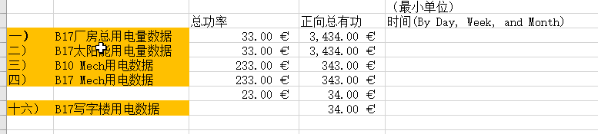
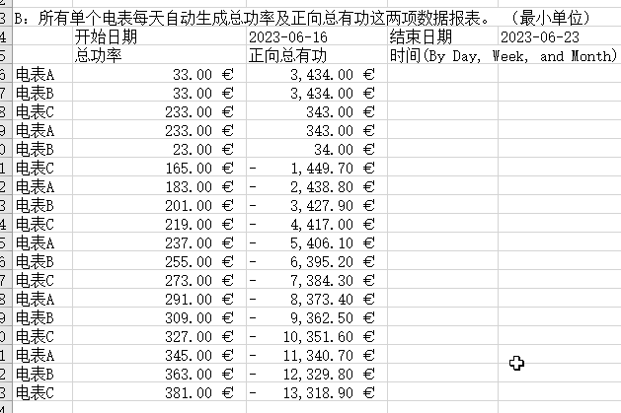
Dashboard Structure
SQL Server DB
This Photo by Unknown Author is licensed under CC BY-SA

